Slide 1
Software Construction and Development
Version Control Systems (Git& GitHub)
Maria Kiran
Email: maria.kiran@ucp.edu.pk
Office: Building A, Faculty Hall F202
OFFICE HOURS: Tue, Wed, Thu (9:00 to 11:00)

Slide 2
Learning Outcomes
Understand Version Control Systems (VCS)
Learn Git basics and commands
Understand GitHub repositories
Perform branching and merging
Understand Pull Requests
Learn collaborative development workflow

Slide 3
What is Version Control?
A system that tracks changes in source code
Allows multiple developers to work together
Stores previous versions of files
Helps recover older versions when needed

Slide 4
Problems Without VCS
File duplication:
  project_final.java
  project_final2.java
  project_latest_final.java
Overwriting teammate work
No backup/history
Difficult collaboration

Slide 5
Benefits of Version Control
Tracks project history
Supports teamwork
Easy backup and recovery
Supports experimentation using branches
Improves software quality

Slide 6
Types of Version Control Systems
Centralized VCS | Distributed VCS
Single central server | Every user has complete copy
Example: SVN | Example: Git
Internet usually required | Can work offline
Less flexible | Highly flexible
Git is a Distributed Version Control System (DVCS).

Slide 7
Introduction to Git
Git is a popular version control system.
It was created by Linus Torvalds in 2005, and has been maintained by Junio Hamano since then.
It is used for:
  Tracking code changes
  Tracking who made changes
  Coding collaboration

Slide 8
Key Git Concepts
Repository: A folder where Git tracks your project and its history.
Clone: Make a copy of a remote repository on your computer.
Stage: Tell Git which changes you want to save next.
Commit: Save a snapshot of your staged changes.
Branch: Work on different versions or features at the same time.
Merge: Combine changes from different branches.
Pull: Get/download the latest changes from a remote repository.
Push: Send/upload your changes to a remote repository.

Slide 9
Working with Git
Initialize Git on a folder, making it a Repository
Git now creates a hidden folder to keep track of changes in that folder
When a file is changed, added or deleted, it is considered modified
You select the modified files you want to Stage
The Staged files are Committed, which prompts Git to store a permanent snapshot of the files
Git allows you to see the full history of every commit.
You can revert back to any previous commit.
Git does not store a separate copy of every file in every commit, but keeps track of changes made in each commit!

Slide 10
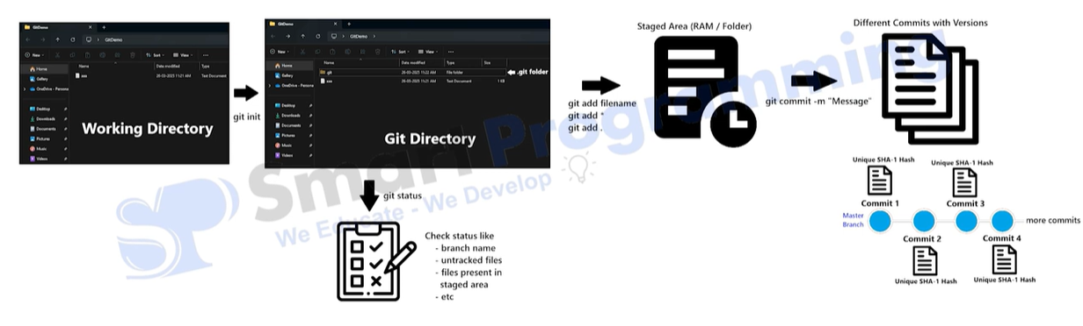
Working with Git

Slide 11
Basic Git Commands (Step-by-Step)
Step | Command | Purpose
1 | mkdir StudentManagementSystem | Create project folder
2 | cd StudentManagementSystem | Move into project directory
3 | git init | Initialize Git repository
4 | git status | Check repository status
5 | touch index.html | Create a new file
6 | git add index.html | Add file to staging area
7 | git add . | Add all files to staging area
8 | git commit -m "Added homepage" | Save snapshot of changes
9 | git log | View commit history
10 | git clone <repository-link> | Copy remote repository
11 | git pull | Download latest updates
12 | git push | Upload local changes to GitHub/GitLab

Slide 12
What is Branching?
A branch is a separate line of development in Git.
  It allows developers to:
  Work on new features safely
  Fix bugs independently
  Experiment without affecting the main project
Real-World Example
  Suppose a team is developing a Library Management System.
Developer | Task
Ali | Login Feature
Sara | Dashboard UI
Ahmed | Payment Module
Each developer works on a separate branch.

Slide 13
Why use Branches?
Without Branches
  The main project may break
  Team members overwrite each other’s work
With Branches
  Safer development
  Better collaboration
  Easier testing

Slide 14
Branching Commands
Command | Purpose
git branch | View all branches
git branch login-feature | Create new branch
git switch login-feature | Switch branch
Learn Git Branching: https://learngitbranching.js.org/

Slide 15
What is Merging?
Merging combines changes from one branch into another branch.
Usually:
  feature branch → main branch
Why Merge?
After completing and testing a feature, developers merge it into the main project.
Merge Commands
  git checkout main
  git merge login-feature
What Happens?
  Git combines:
  files
  code changes
  commits
  from: login-feature into main

Slide 16
Merge Conflicts
Occurs when:
Two developers edit the same line
Git cannot decide which version to keep
Example
  Developer A: <h1>Library System</h1>
  Developer B: <h1>Online Library</h1>
Git Conflict Markers
  <<<<<<< HEAD
  Library System
  =======
  Online Library
  >>>>>>> login-feature
Solution
  Developer manually:
  chooses correct code
  removes conflict markers
  commits resolved version

Slide 17
Pull Requests
A Pull Request is a request to merge code into another branch.
Mostly used on:
  GitHub
  GitLab
Industry Importance
Almost every software company uses Pull Requests for teamwork and review process for:
    Code review
    Team discussion
    Detect bugs
    Improve code quality

Slide 18
Introduction to GitHub
Cloud platforms for hosting repositories
Enable collaboration between developers
Provide Pull Requests and issue tracking
Used in industry-level development

Slide 19
Git vs GitHub
Git = Version Control Tool
GitHub = Cloud Hosting Platform
Git works locally
GitHub enables collaboration online

Slide 20
Collaborative Development Workflow
Clone repository
Create a branch
Write code
Commit changes
Push branch
Create Pull Request
Review and Merge

